Slide 1
CSE3002 PROJECT
COURSE NAME : Internet and Web Programming
MEMBERS : HARSH PARWAL (20BCE1929)

Slide 2
OPTIMIZING A WEBPAGE AND BOOTSTRAP

Slide 3
INTRODUCTION
Bootstrap is a open source CSS framework for mobile’s front end development. It contains HTML,CSS and JS based design templates. It is designed to develop a responsive enabled dev of mobile based application.The style pages have been facilitating the elaboration of web pages for some years now. However, programmers have not created any framework to optimize the size of the interfaces automatically. Currently the usage of mobile applications is on peak and it requires the optimization to create a GUI for mobile applications which was previously designed for windows computers. The essence of creating a responsive design is to have a website that is mobile-first and responsive, organized from navigation, content, and images that are scalable across multiple devices.

Slide 4
PROBLEM
A desktop based website is generally not much responsive and take a little more load time on other screen types (smartphones , tablets) . Also the desktop based webpage do not automatically adjust its screen resolution on other hybrid devices. The website will be not much mobile friendly without optimization and also it could lead to higher bounce rates and a lower Search Engine Results Page (SERP) ranking. Also the load balancing is the big challenge to decrease the load time of the website. The main result of load balancing is minimizing resource use.

Slide 5
OBJECTIVE
We will be designing a webpage that will be optimized not only for desktop but for other screen types also. The webpage will take less load time and a good response time over cloud. The website will retains users’ attention and present it to all internet users in the most convenient way possible. We will evaluate the optimized webpage with and without bootstrap and graphics optimization. The results will be showed in form of mathematical terms and graphs. Our main objective of this project is to reduce the response time to improve performance and user satisfaction.

Slide 6
EXISTING SYSTEM
The current existing systems are working on graphics optimization but not able to optimized for all screen types. Like for lower resolution like 480x800 the websites are not much optimized. We would optimize the load balance for the system and the resource allocation techniques to improve the speed of the system. The main factors that load balancing needs to resolving is poor infrastructure, poor network traffic management, low network reliability, resulting imbalance in server clusters.

Slide 7
Proposed system
Our proposed system will work efficiently on low resolution devices as well as existing devices. Also our system will be more optimized and refined to work on cloud systems. Our system will load more quickly over cloud system which we will test on virtual machines to stimulate the results.
The run time and load time will be minimised. We will try to balance the load
For the system and the resource allocation tecniques so that the website would work more efficiently and fast.

Slide 8
TOOLS USED
HTML
JAVASCRIPT
CSS
PHP
VS CODE STUDIO
VMWARE

Slide 9
Bootstrap for high resolution
Current bootstrap works till only 1200px , we have modified the script to work with high resolution to make it more interactive. It can even support 8k resolution devices efficiently. The only drawback of applying bootstrap for high resolution devices is that it decrease the performance of the website , in short it affects load time very much. So we have tried to optimize the page in such a way that it works with high res devices with less load time.

Slide 10
algorithm
1. Adding col-xga (1600+), col-fhd (1920+), col-rt (2560+), col-rt15 (2880+), col-uhd (3840+), col-4k (4096+), col-8k (8192+) classes with all related options: order, offser
2. Adding options none, inline, inline-block, block, table, table-row, table-cell, flex, inline-flex for all three
3. Adding options flex-, justify-content-, align-items-, align-content-, align-self* for all three

Slide 11
Grid behaviour and prefix used
HD+ ≥1600px : .col-xga-
Full HD 1080p ≥1920px : .col-fhd-
Retina 1440p ≥2560px : .col-rt-
15" Retina ≥2880px : .col-rt15-
UHD ≥3840px : .col-uhd-
4K ≥4096px : .col-4k-
8K ≥8192px : .col-8k-

Slide 12
OPTIMIZATION of index page
Our index page originally had a Google PageSpeed score of 35/100 for mobile and 47/100 for desktop. After making changes the score increased to 99/100 for both mobile and desktop. The drastic changes were due to the changes we made in the page which we will discuss in next slides.

Slide 13
Changes in index page
css : Inlined all of the CSS into the head of the document and added the HTML media="print" attribute to the external style sheet link for print styles.
Js : Added the HTML async attribute to all script tags and used the Brunch build tool to concatenate and minify.
Images : Resized images that were too large and compressed all images with the image compression tool.
Browser Caching : Leveraged browser caching by including an .htaccess file in the root of the website. The file contains expires headers, which sets long expiration times for all CSS, JavaScript and images.

Slide 14
Optimization of pizza site
We tried to optimize the pizza site to fix low FPS to produce consistent 60fps when scrolling the webpage. The website is both bootstrapped and optimized for its best performance even though it has a large amount of graphical data present. Changes which were made are dicussed in the upcoming slides.

Slide 15
Optimized loops
Optimized the loops contained in the updatePositions function and the onDOMContentLoaded event handler.
function updatePositions() {
frame++;
window.performance.mark("mark_start_frame");
var items = document.querySelectorAll('.mover');
for (var i = items.length; i--;) {
var phase = Math.sin((document.body.scrollTop / 1250) + (i % 5));
items[i].style.left = items[i].basicLeft + 100 * phase + 'px';
}

Slide 16
Reducing the pizza elements
We have reduced the amount of slinding pizza elements from 231 to 42 which sufficiently fills the screen with pizza.
document.addEventListener('DOMContentLoaded', function() {
var cols = 8;
var s = 256;
for (var i = 200; i--;) {
var elem = document.createElement('img');
elem.className = 'mover';
elem.src = "../public/img/pizza.png";
elem.style.height = "100px";
elem.style.width = "73.333px";
elem.basicLeft = (i % cols) * s;
elem.style.top = (Math.floor(i / cols) * s) + 'px';
document.querySelector("#movingPizzas1").appendChild(elem);
}
updatePositions();
});

Slide 17
Optimized css animation and improved efficiency
Applied translateX() and translateZ(0) transform functions to the sliding pizza elements within the updatePositions function.
Moved the calculation which utilizes the scrollTop method outside of the loop.

Slide 18
function updatePositions() {
frame++;
window.performance.mark("mark_start_frame");
var items = document.querySelectorAll('.mover');
var top = (document.body.scrollTop / 1250);
for (var i = items.length; i--;) {
var phase = Math.sin( top + (i % 5));
//items[i].style.left = items[i].basicLeft + 100 * phase + 'px';
var left = -items[i].basicLeft + 1000 * phase + 'px';
items[i].style.transform = "translateX("+left+") translateZ(0)";
}
window.performance.mark("mark_end_frame");
window.performance.measure("measure_frame_duration", "mark_start_frame", "mark_end_frame");
if (frame % 10 === 0) {
var timesToUpdatePosition = window.performance.getEntriesByName("measure_frame_duration");
logAverageFrame(timesToUpdatePosition);
}
}

Slide 19
Fixing browser paint events
Removed height and width styles from the generated pizza elements and resized the pizza image to 100 x 100 to prevent the browser from having to resize the images.
document.addEventListener('DOMContentLoaded', function() {
var cols = 8;
var s = 256;
for (var i = 31; i--;) {
var elem = document.createElement('img');
elem.className = 'mover';
elem.src = "../public/img/pizza-slider.png";
elem.basicLeft = (i % cols) * s;
elem.style.top = (Math.floor(i / cols) * s) + 'px';
document.querySelector("#movingPizzas1").appendChild(elem);
}
updatePositions();
});

Slide 20
Optimized animations
Added the updatePositions function as a parameter to the window.requestAnimationFrame method in the scroll event listener which optimizes concurrent animations together into a single reflow and repaint cycle.
window.addEventListener('scroll', function() {
window.requestAnimationFrame(updatePositions);
});

Slide 21
Resized pizza
Improved Efficiency
function changePizzaSizes(size) {
var dx = determineDx(document.querySelector(".randomPizzaContainer"), size);
for (var i = 0; i < document.querySelectorAll(".randomPizzaContainer").length; i++) {
var newwidth = (document.querySelectorAll(".randomPizzaContainer")[i].offsetWidth + dx) + 'px';
document.querySelectorAll(".randomPizzaContainer")[i].style.width = newwidth;
}
}

Slide 22
Moved the newwidth calculation inside the changePizzaSizes function out of the loop. Again, selected only the first .randomPizzaContainer element in the document.
function changePizzaSizes(size) {
var dx = determineDx(document.querySelector(".randomPizzaContainer"), size);
var newwidth = (document.querySelector(".randomPizzaContainer").offsetWidth + dx) + 'px';
for (var i = 0; i < document.querySelectorAll(".randomPizzaContainer").length; i++) {
document.querySelectorAll(".randomPizzaContainer")[i].style.width = newwidth;
}
}

Slide 23
Created a new variable to hold all of the .randomPizzaContainer elements in the document and looped through the elements to apply the new width value.
function changePizzaSizes(size) {
var dx = determineDx(document.querySelector(".randomPizzaContainer"), size);
var newwidth = (document.querySelector(".randomPizzaContainer").offsetWidth + dx) + 'px';
var elements = document.querySelectorAll(".randomPizzaContainer");
for (var i = 0; i < elements.length; i++) {
elements[i].style.width = newwidth;
}
}

Slide 24
Future work
As we know that bootstrap is css based so in overall performance it increases the load time and latency. For now we have successfully optimized a more refined and upgraded version of bootstrap. It has gradually increased the load time. Next we will try to decrease the load time by applying certain algorithms so that we can get a better , fast and more optimized website.

Slide 25
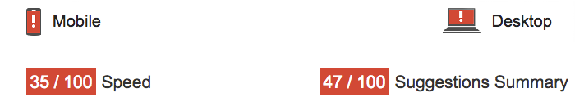
Performance outputs
INDEX PAGE
Page speed score before fix

Slide 26
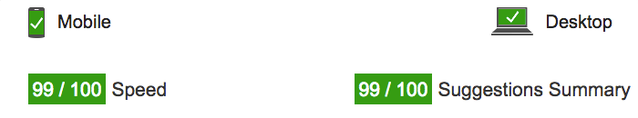
Page speed score after fix

Slide 27
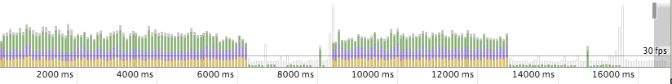
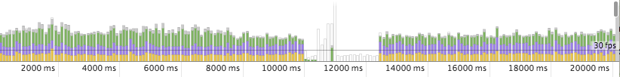
PIZZA SITE
FPS BEFORE ANY FIX
After optimizing loops

Slide 28
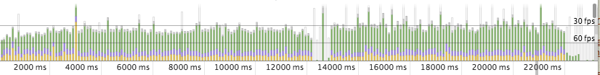
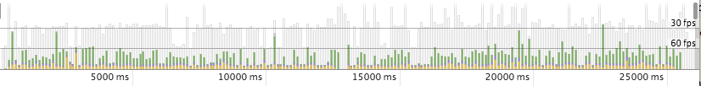
After reducing the number of sliding pizzas generated from 231 to 42
After applying translateX() and translateZ(0) transform functions to the sliding pizza elements

Slide 29
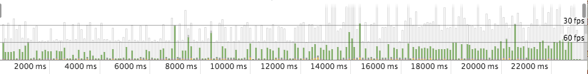
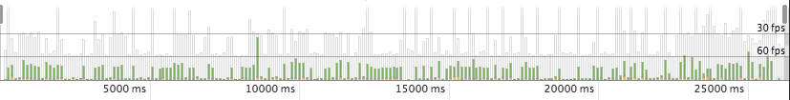
After removing height & width styles from pizza image tag and resizing the image
After including window.requestAnimationFrame method within scroll event handler

Slide 30
conclusion
For now we have developed an optimized website which is compatible for working on any platform with any resolution upto 8k. Although it has increased its load time and latency. We have managed to decrease it by optimizing it using different approach.

Slide 31
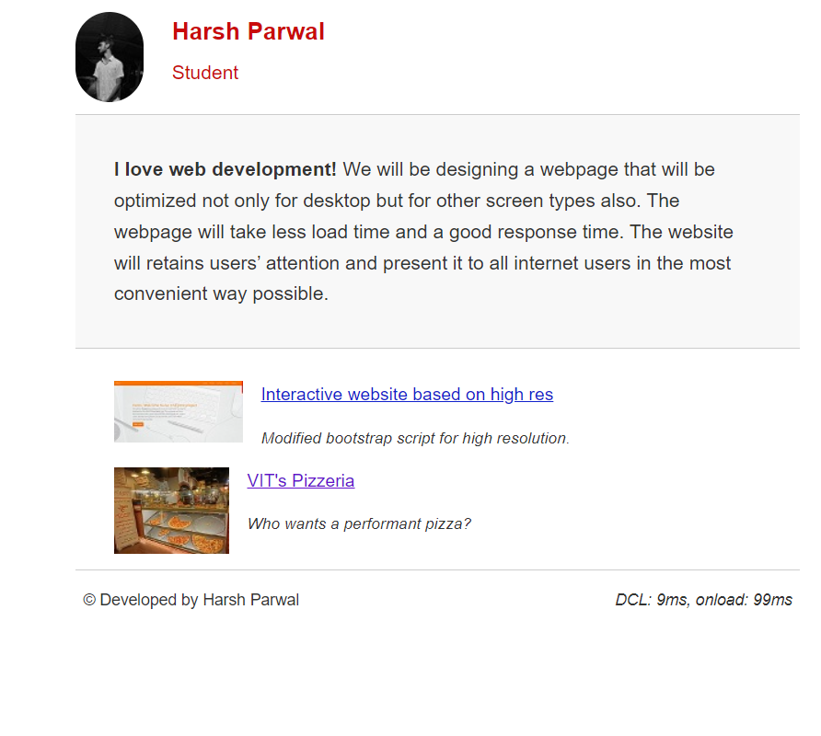
outputs
INDEX PAGE

Slide 32
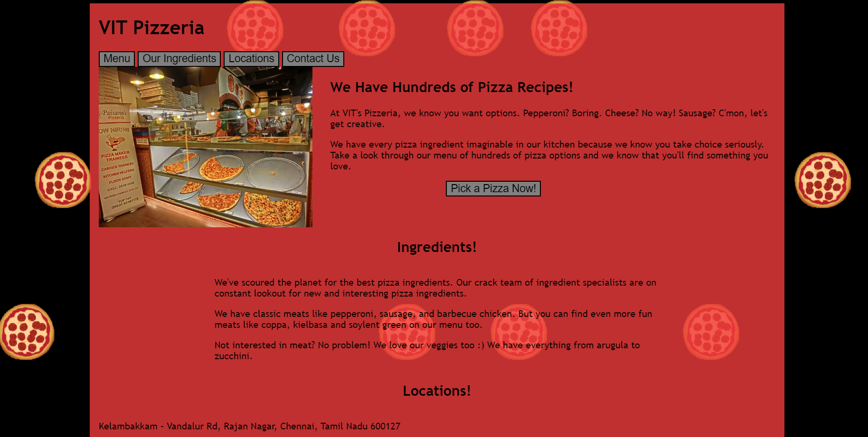
VIT PIZZERIA

Slide 33
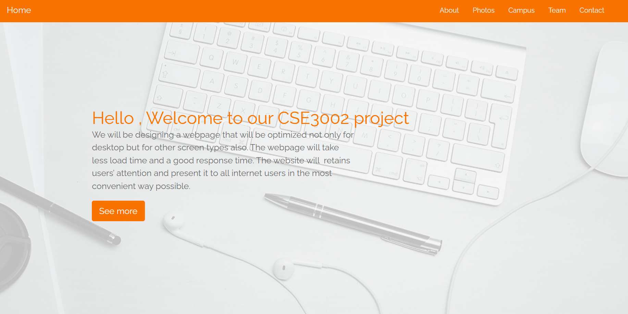
HIGH RESOLUTION WEBSITE

Slide 34
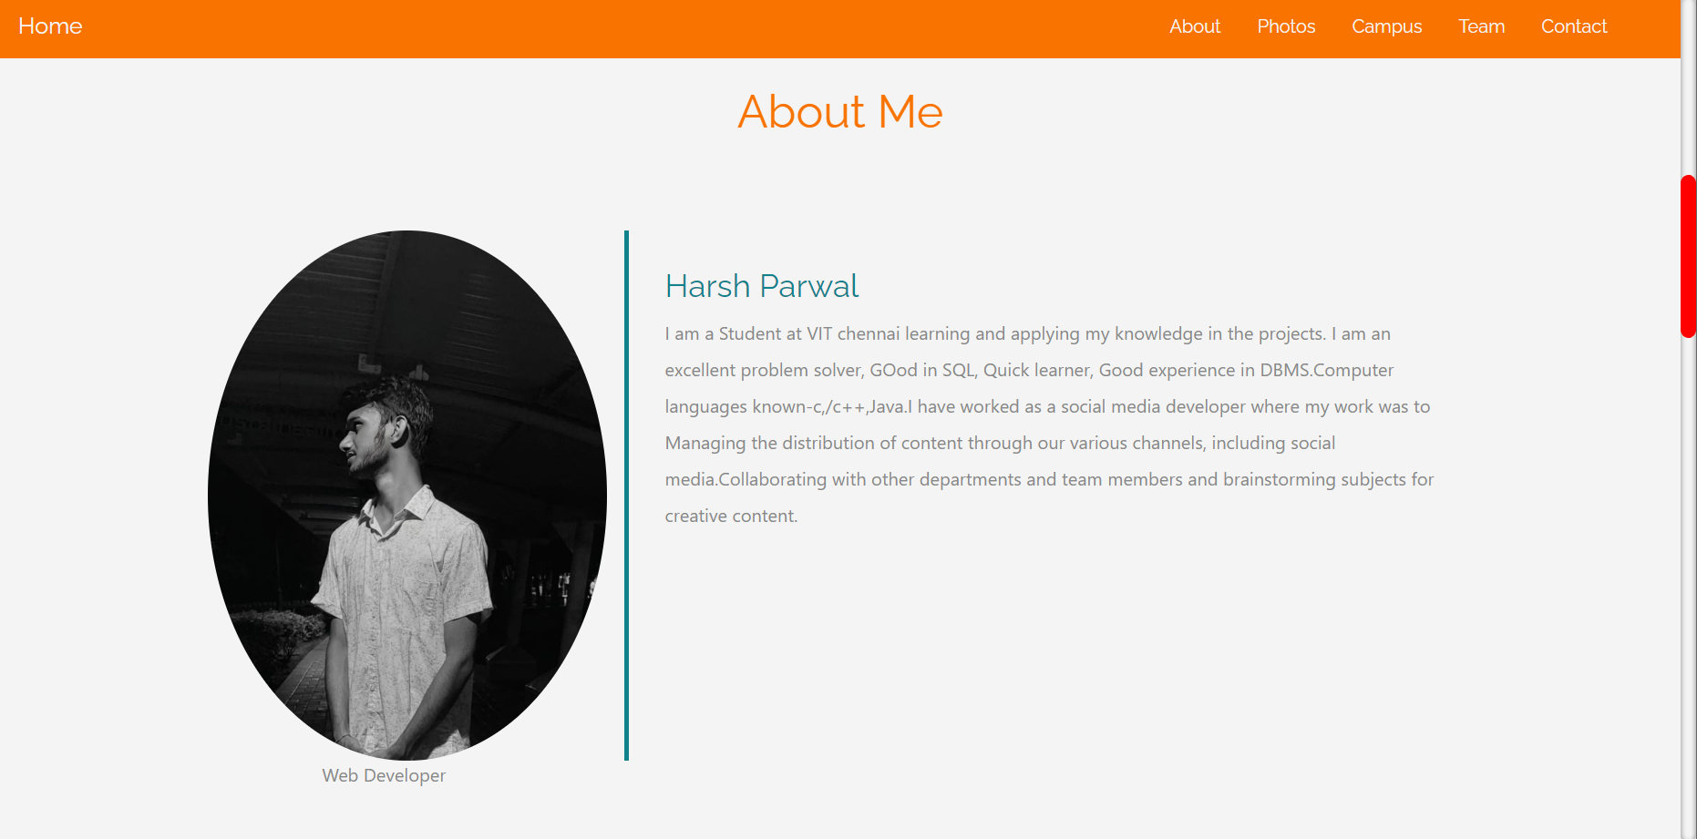

Slide 35
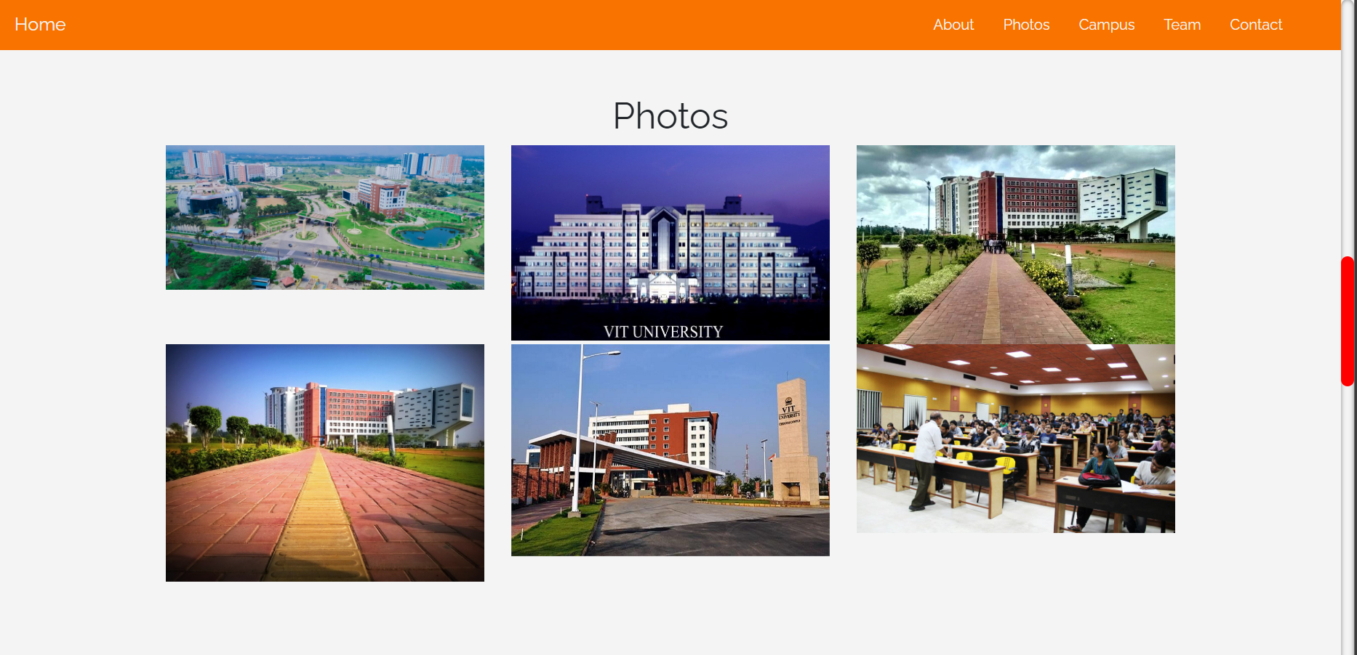

Slide 36
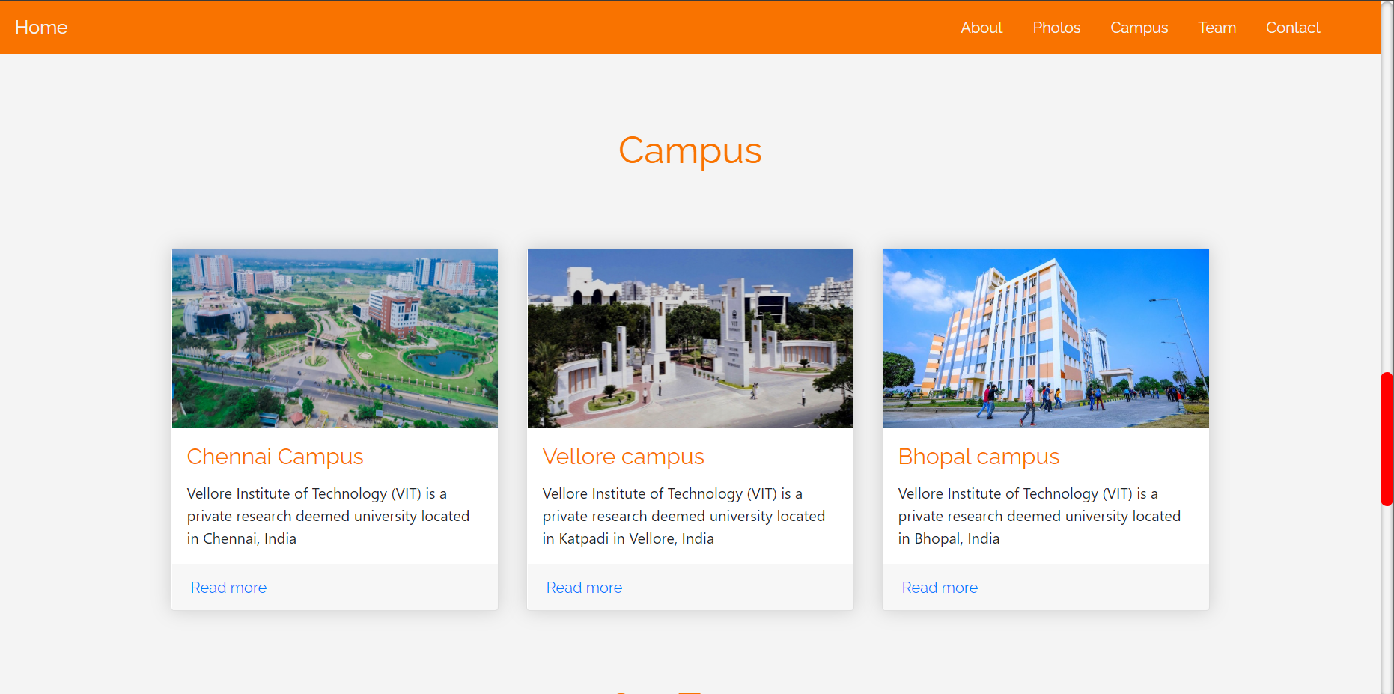

Slide 37
FUTURE WORK
We have not tested how our website will work on cloud when multiple devices will try to access the website where concepts of cloud computing can be used. A good load balancing is equally required with the optimized website so that the website performance does not degrades. For future work we can test our website by accessing it by different virtual machines at same time and try to fix load balancing factor.

Slide 38
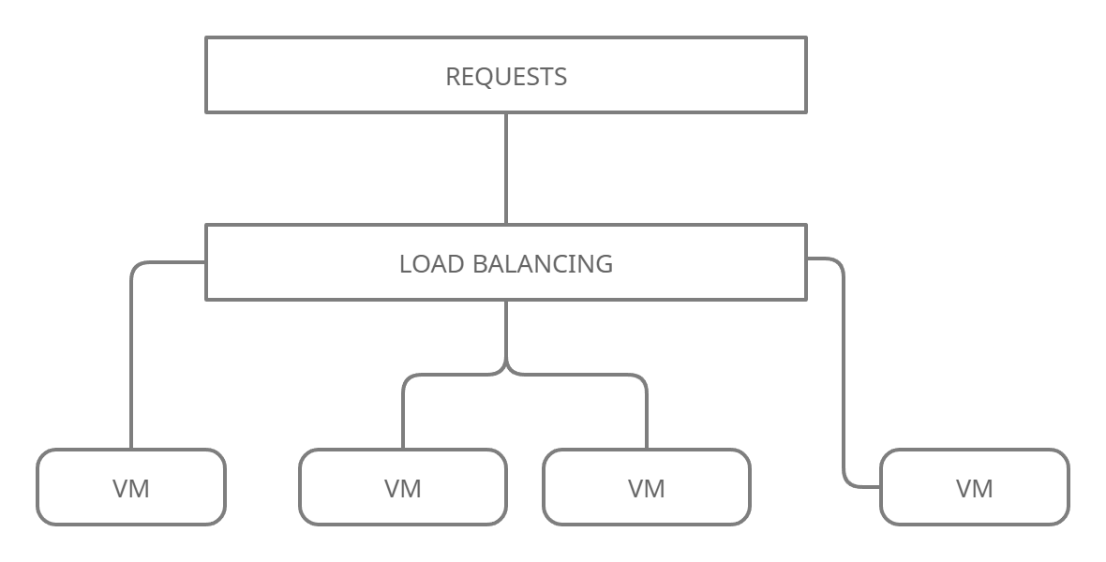
Future mODEL

Slide 39
REFERENCES
López-Gorozabel, Oscar & Cedeño Palma, Emilio & Pinargote-Ortega, Jenmer & Romero, Walter & Pazmiño-Campuzano, Marcos. (2021). Bootstrap as a Tool for Web Development and Graphic Optimization on Mobile Devices. 10.1007/978-3-030-68080-0_22.
Fernando Almeida, Centre for Innovation, Technology and Entrepreneurship, INESC TEC, Porto, Portugal. José Monteiro Higher Polytechnic Institute of Gaya, ISPGaya, V.N.Gaia, Portugal. The Role of Responsive Design in Web Development
Setiawan, Agus & Harahap, Zulkifli & Syamsuar, Dedy & Kunang, Yesi. (2020). The Optimization of Website Visibility and Traffic by Implementing Search Engine Optimization (SEO) in Palembang Polytechnic of Tourism. CommIT (Communication and Information Technology) Journal. 14. 31. 10.21512/commit.v14i1.5953.
Król, Karol & Zdonek, Dariusz. (2020). Website optimisation for search engines concept of website profiling. Scientific Papers of Silesian University of Technology Organization and Management Series. 2020. 10.29119/1641-3466.2020.144.23.
Simisaye, Ahmed & Adeleke, Osisanwo & Toluwanimi, Ariori & Olatope, Oyedokun & Abiodun, Oladipupo. (2022). Analysis and Usability of Selected University Library Websites in South-west Nigeria. 5. 1238-1260.

Slide 40
6. Sadeeq, Mohammed & Zeebaree, Subhi. (2021). Semantic Search Engine Optimisation (SSEO) for Dynamic Websites: A Review. 5. 148-158. 10.5281/zenodo.4536804.
7. Suzanti, Ika & Mufarroha, Fifin & Fatimah, Khusnul & Fatah, Doni & Sukri, Hanifudin & Dafid, Ach. (2022). IMPLEMENTATION OF WEBSITE PERFORMANCE EVALUATION WITH SIMILARWEB ON ACADEMIC WEBSITES. Jurnal Simantec. 10. 85-92. 10.21107/simantec.v10i2.14234.
8. Meenakumari, R & Muthusamy, Suresh. (2021). An improved genetic algorithm-based optimal sizing of solar photovoltaic/wind turbine generator/diesel generator/battery connected hybrid energy systems for standalone applications An improved genetic algorithm-based optimal sizing of solar photovoltaic/wind turbine generator/diesel generator/battery connected hybrid energy systems for standalone applications. International Journal of Ambient Energy. 42. 1136-1143.\
9. Kamiyama, Noriaki & Nakano, Yuusuke & Shiomoto, Kohei & Hasegawa, Go & Murata, Masayuki & Miyahara, Hideo. (2016). Analyzing Effect of Edge Computing on Reduction of Web Response Time. 1-6. 10.1109/GLOCOM.2016.7841607.
10. Tiwari, Shraddha & Gupta, Rajeev & Kashyap, Ramgopal. (2019). To Enhance Web Response Time Using Agglomerative Clustering Technique for Web Navigation Recommendation. 10.1007/978-981-10-8055-5_59.

Slide 41


